Slide 1

Chapter 7
Mindful Listening

Slide 2
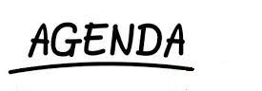
The Listening Process
Effective Listening
Non-Listening
Listening Goals
Guidelines

Slide 3
The Listening Process
What is the difference between listening and hearing?

Slide 4
The Listening Process
Listening:
Active
Effortful
Engage with content
Evaluate content
Hearing:
Passive
Effortless
No active engagement with content

Slide 5

The Listening Process
Hearing is a physiological activity that occurs when sound waves hit our eardrums.

Slide 6
The Listening Process (cont’d)
Attention
Selection (memory)
Organization
Interpretation
Response
Retention

Slide 7
Attention
Selective Attention
Based on person perception
Person-centered
Who you are determines what is important to you

Slide 8
Selection
Brain is powerful but has limited capacity to process in formation
You do not retain all the information that comes in from the five senses.
Sensory memory – Short term memory – Long term memory

Slide 9
Organization
How do we categorize information?
Biases? Perceptions?
Stereotypes?
Brain tends to focus on the first, most used, and last stimuli (primary recency effects)

Slide 10

Physically Receiving Messages
F = face the speaker
E = eye contact
L = lean forward
O = open posture
R = relax

Slide 11
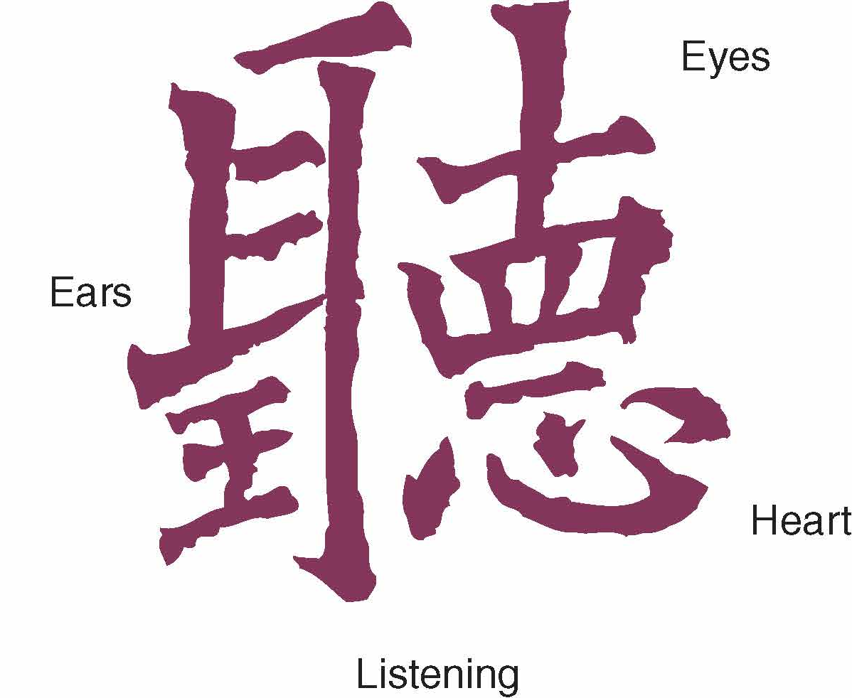
Mindfulness is being fully present in the moment
Mindfulness

Slide 12
Interpreting Communication
dual
perspective

Slide 13

Responding
Responding includes several effective skills:
Paraphrasing
Encouraging
Questioning
Summarizing
Supporting

Slide 14



Obstacles to Effective Listening
Internal Obstacles
Preoccupation
Prejudgment
Lack of effort
Not recognizing diverse listening styles
Our desire to “fix”

Slide 15
Obstacles to Effective Listening (cont’d)
External Obstacles
Message Overload
Processing rate, Information overload
Message Complexity
Noise
Physical, psychological, and semantic

Slide 16
Forms of Non-listening
Pseudolistening
Monopolizing
Selective Listening
Defensive Listening
Ambushing
Literal Listening

Slide 17
Adapting Listening to Communication Goals
Listening for Pleasure
Listening for Information
Listening to Support Others

Slide 18
Guidelines for Effective Listening
Be Mindful
Adapt Listening Appropriately
Listen Actively

Slide 19
Summary
Listening vs. Hearing
Guidelines
Listening Process
Chapter 7
Non-Listening
Effective Listening
Mindfulness
Obstacles

